Slide 1

Detecting Logging of Forest Trees using Sound Event Detection
Major Project Phase - II
Review – 1
Team Members (Team - 17)
19K41A0594 - B.RAJU
19K41A0510 - JINUKALA VAMSHI
19K41A0517 - MOHAMMED RAAMIZUDDIN
19K41A05E9 - BHONAGIRI SHREYA
19K41A05F7 - JUPALLY YOCHITHA
Project Guide
Sallauddin Mohmmad
Assistant Professor

Slide 2
Introduction
Domain:
Prevention of illegal logging of forest trees and preserving natural resources.
As tree cutting generates lot of noise, it can be detected by regularly monitoring the acoustic signals inside the forest.
Implementation Domain:
In the context of our project domain, we will be using a deep learning techniques.
Deep learning is a type of Artificial Intelligence that imitates the way humans gain certain type of knowledge.
MJP (DLFTSED) Team – 17 P-II Review – 1 (AY: 2022-2023)

Slide 3
Problem Statement
In forests, tree cutting activities are illegal but due to shortage of manpower and other resources, governments are not very successful in curbing this menace.
India is placed on third position for illegally importing logged timber in the world.
The issue of this level illicit logging must be dealt very seriously as it exhausts the forest assets.
Monitoring the forest assets visually requires a lot of equipment.
An acoustic signature can provide valuable information about the activities of any intruder inside the forest.
MJP (DLFTSED) Team – 17 P-II Review – 1 (AY: 2022-2023)

Slide 4
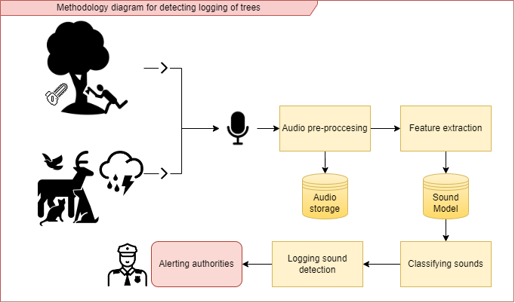
Methodology
The solution to the mentioned problem can be achieved by using the below workflow :
Block Diagram
MJP (DLFTSED) Team – 17 P-II Review – 1 (AY: 2022-2023)

Slide 5
Project Timeline
Research
Gathering Data
Processing Data
Model Training & Result Analysis
Deployment
MJP (DLFTSED) Team – 17 P-II Review – 1 (AY: 2022-2023)

Slide 6
Research Outcomes
The research done on sound event detection usually comprises of the following steps:
1. Collecting the sound signals or audio data,
2. Extracting the crucial features from the audio data,
3. Making clusters of identical features or labelling the data,
4. Classifying the features.
Most of the authors used the coefficients of Mel frequency cepstrum to extract the features which are used for classifying the sounds by CNN or GMM.
Further, after these features are classified, the environmental audio scene is also identified using the Neural Network.
MJP (DLFTSED) Team – 17 P-II Review – 1 (AY: 2022-2023)

Slide 7


Dataset
The dataset that we will be using is an environmental dataset that contains of Tree logging sounds as well as the sounds that can be classified into this class by collecting the sound samples corresponding to it.
The dataset should also contain some negative classes, complexity of the dataset would be high.
The Dataset considered consists of six classes (Chainsaw, Handsaw, Axe cutting, Wind, Forest, Rain and Thunder Sounds) that should be categorized according to the samples collected.
Collected Audio Files
MJP (DLFTSED) Team – 17 P-II Review – 1 (AY: 2022-2023)

Slide 8
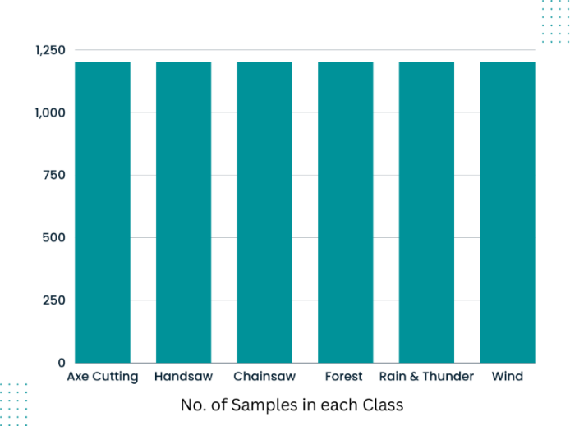
Dataset (Contd.)
The audio data was collected from various sources such as AudioSet and by manually collecting the data. Each class of audio had hours content in it, the audio was split into ten seconds from the hours long file to get more samples.
Each class has 1200 samples. Therefore, 7200 audio files of ten seconds each for all the classes.
MJP (DLFTSED) Team – 17 P-II Review – 1 (AY: 2022-2023)

Slide 9
Audio Pre-Processing
Sampling and Sampling Frequency determination.
sampling is the reduction of a continuous signal into a series of discrete values.
The sampling frequency or rate is the number of samples taken over some fixed amount of time.
Amplitude determination.
The amplitude of a sound wave is a measure of its change over a period (usually of time).
Bit-rate Conversion.
Bit-rate is the number of bits per second that can be transmitted along a digital network.
Audio Channel Manipulation.
Audio Channel is a single stream of recorded sound with a location in a sound field.
Bit-depth Conversion.
The audio bit depth determines the number of possible amplitude values we can record for each audio sample.
MJP (DLFTSED) Team – 17 P-II Review – 1 (AY: 2022-2023)

Slide 10
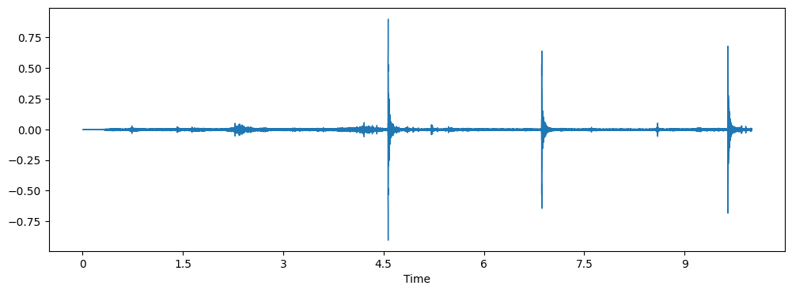
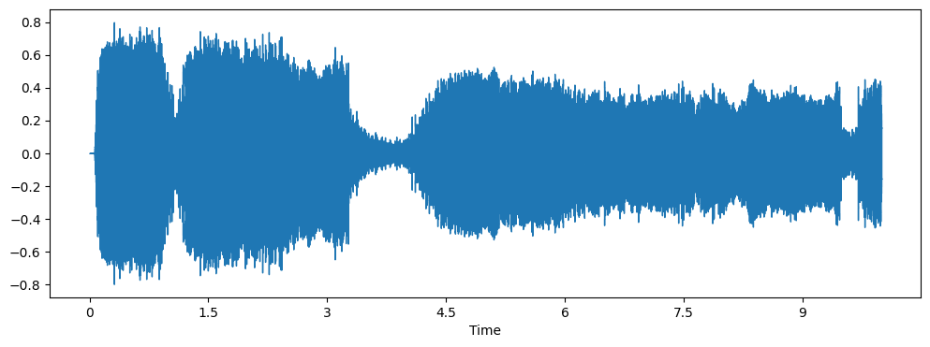
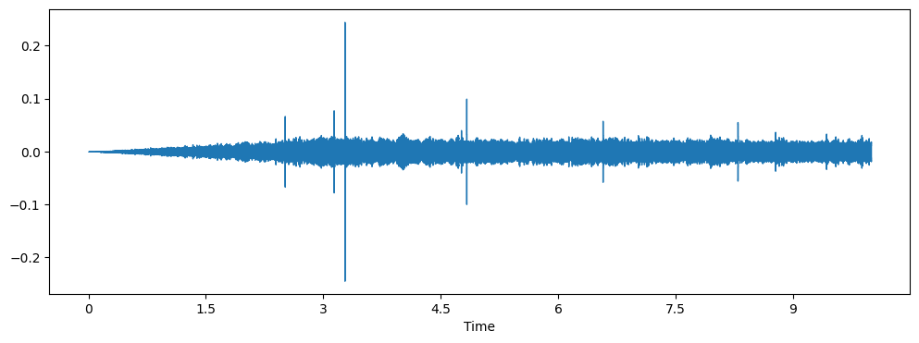
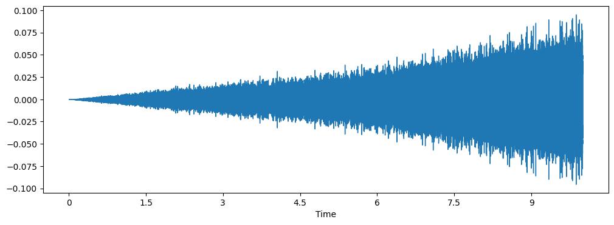
Audio Waveforms
Below are the audio waveform representations of some audio classes after applying the pre-processing steps:
Axe cutting Sounds
Chainsaw Sounds
Forest Sounds
Wind Sounds
MJP (DLFTSED) Team – 17 P-II Review – 1 (AY: 2022-2023)

Slide 11
Feature Extraction
MFCC
The Mel-frequency Cepstrum coefficient is a representation of the short-term power spectrum of a sound.
SPECTRAL CONTRAST
The Spectral Contrast used to make decibel difference between peaks and valleys, that helps for echancing of sounds.
MEL-SPECTROGRAM
Mel-Spectrogram is used for rendering the frequencies above certain threshold.
CHROMA
The Chroma value of an audio basically represent the intensity of the twelve distinctive pitch classes that are used to study music.
TONNETZ
Tonnetz is used for computing the tonal centroid features of sound.
MJP (DLFTSED) Team – 17 P-II Review – 1 (AY: 2022-2023)

Slide 12
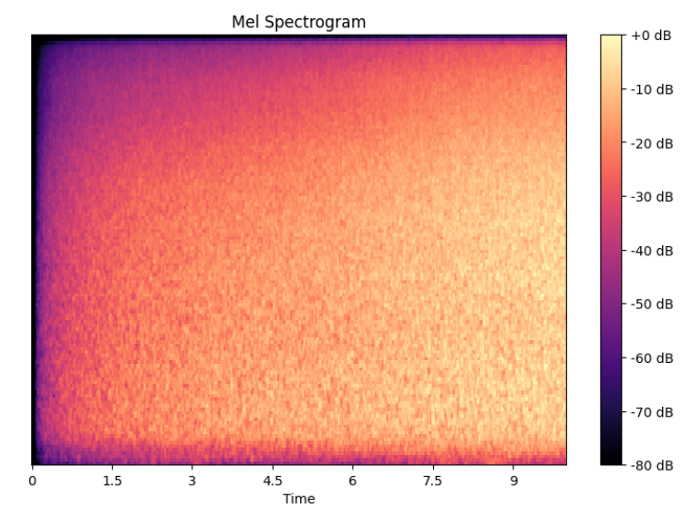
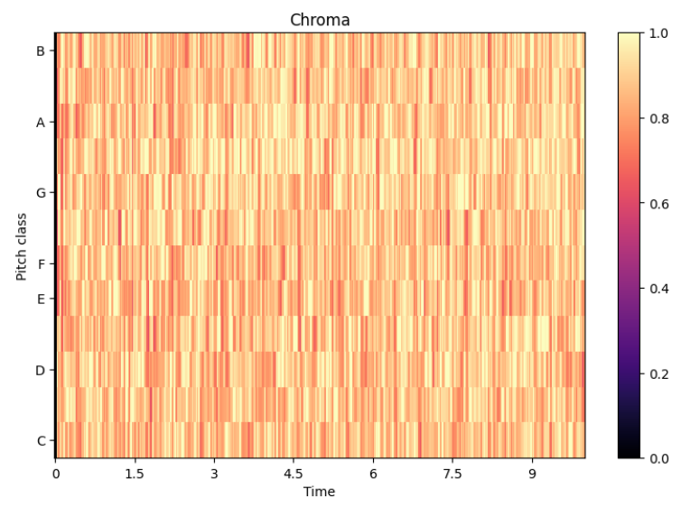
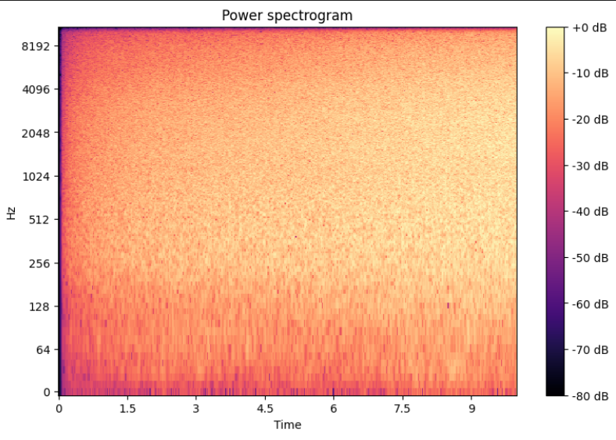
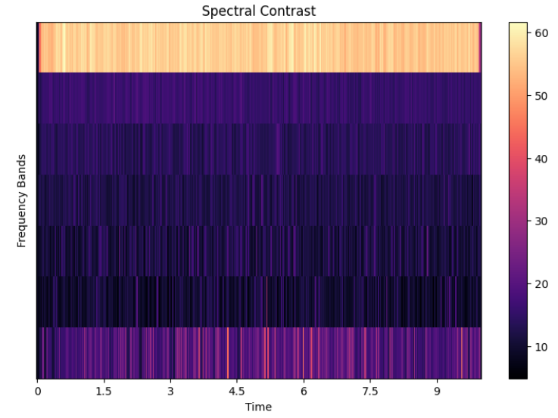
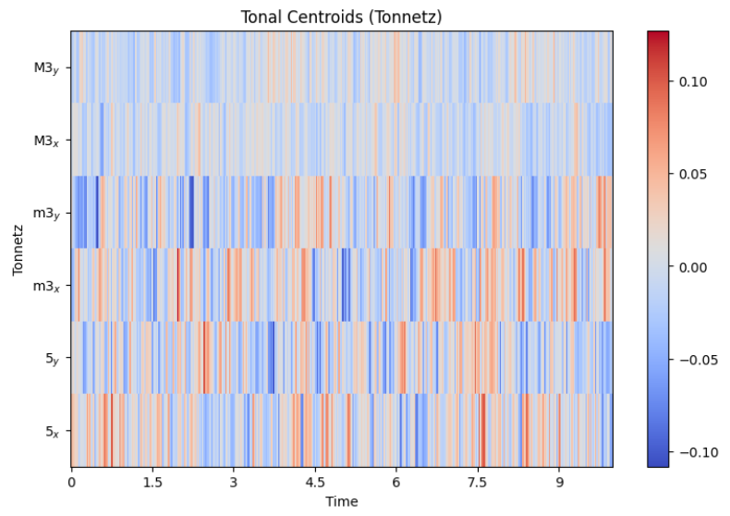
Feature Extraction (Contd.)
Below are the representations of various feature extraction techniques:
MJP (DLFTSED) Team – 17 P-II Review – 1 (AY: 2022-2023)

Slide 13
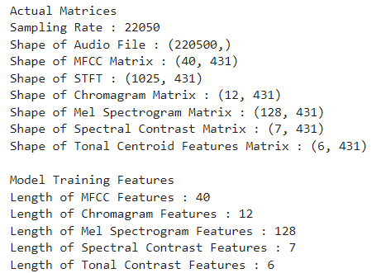
Applying Feature Extraction
The applied feature extraction techniques are:
Mel-frequency cepstral coefficients (MFCC)
Chroma (STFT)
Mel Spectrogram
Contrast
Tonnetz
Feature Dimensions
MJP (DLFTSED) Team – 17 P-II Review – 1 (AY: 2022-2023)

Slide 14
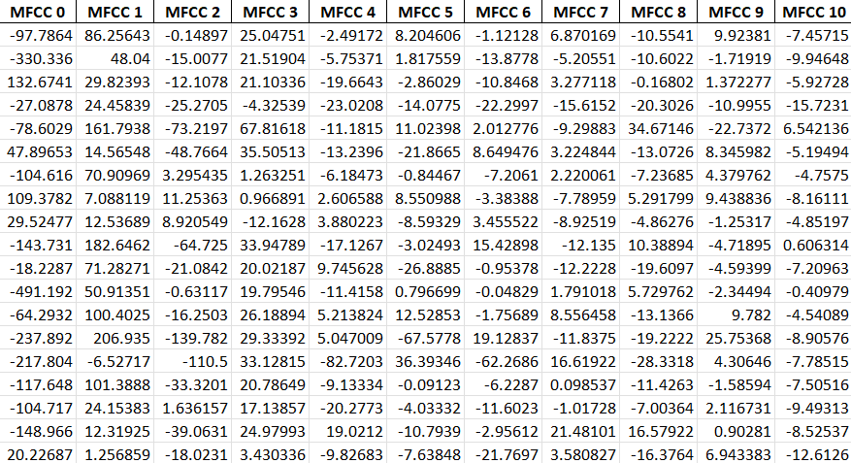
Time-series Dataset
Extracted Features
MJP (DLFTSED) Team – 17 P-II Review – 1 (AY: 2022-2023)

Slide 15
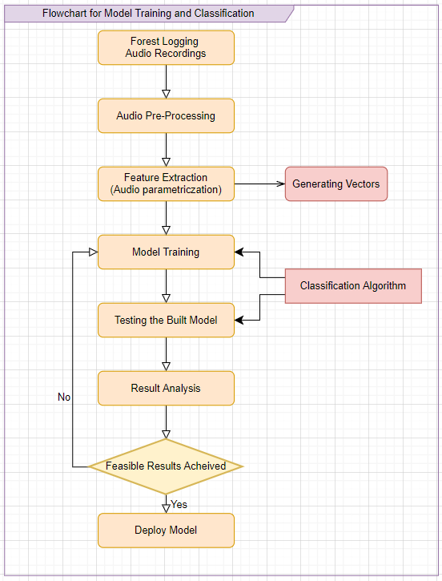
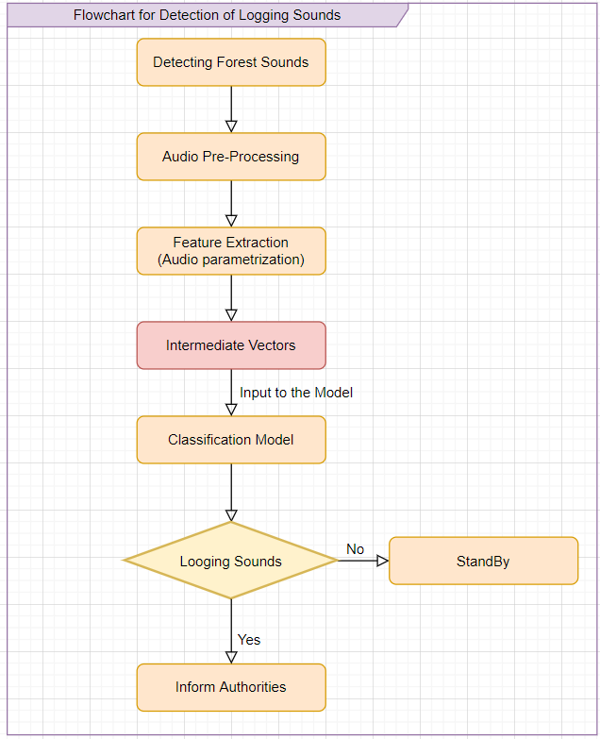
Flowchart for Model Training
MJP (DLFTSED) Team – 17 P-II Review – 1 (AY: 2022-2023)

Slide 16
Models Used
After extracting the feature vectors as dataset, then we performed the model training. We used various models and compared them.
The models considered for analysis at this stage are:
Convolutional Neural Network (CNN).
Bi-directional Convolutional Recurrent Neural Network (BICRNN).
The models developed are custom, the architecture of the networks in not pre-determined, the layers of the networks were determined according to the time-series data generated.
These models are considered for analyzing the results and improving the efficiency of classification further by altering the architecture or tuning the hyperparameters.
MJP (DLFTSED) Team – 17 P-II Review – 1 (AY: 2022-2023)

Slide 17
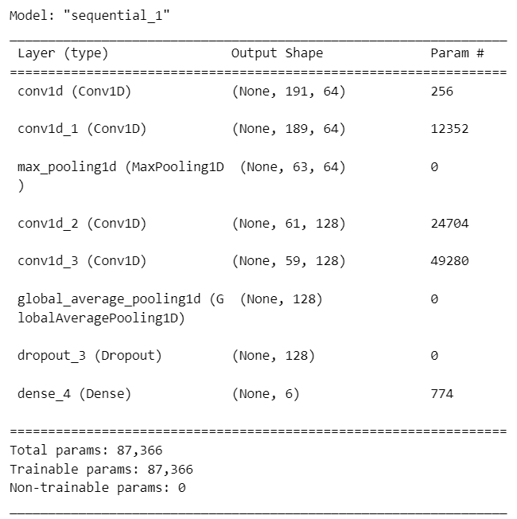
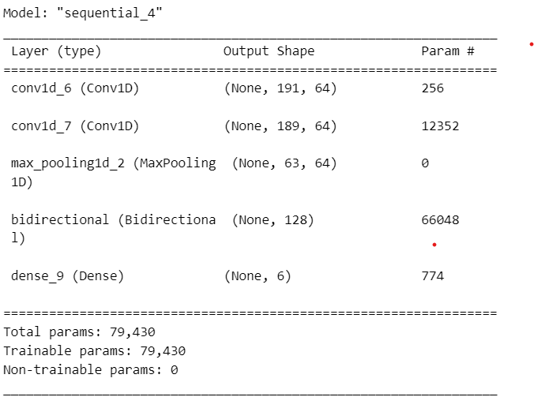
Model Architecture
The architectures of models are represented below:
CNN
BICRNN
MJP (DLFTSED) Team – 17 P-II Review – 1 (AY: 2022-2023)

Slide 18
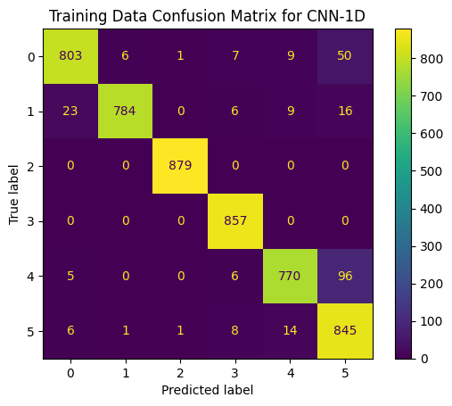
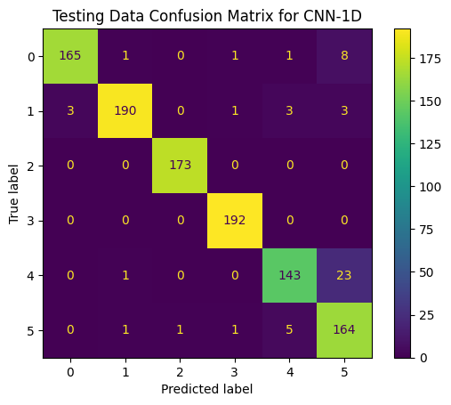
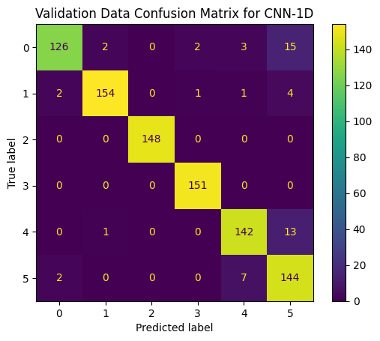
Result Analysis
The training for each model took approximately ~25 minutes.
The Confusion matrices of Convolutional Neural network is given below:
MJP (DLFTSED) Team – 17 P-II Review – 1 (AY: 2022-2023)

Slide 19
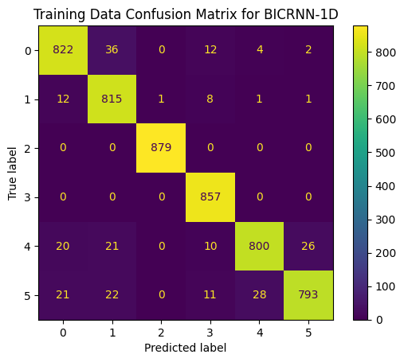
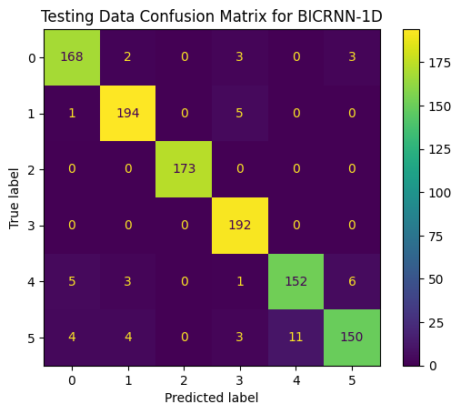
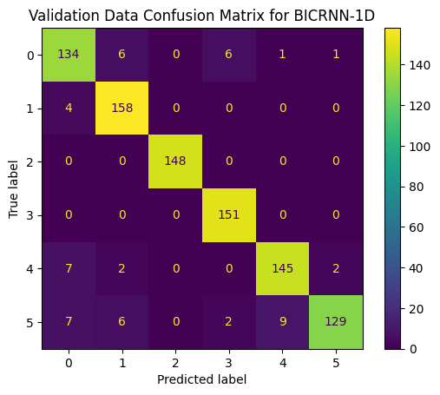
Result Analysis (Contd.)
The Confusion matrices of Bidirectional Convolutional Recurrent Neural network is given below:
MJP (DLFTSED) Team – 17 P-II Review – 1 (AY: 2022-2023)

Slide 20
Result Analysis (Contd.)
Accuracy and loss for CNN and BICRNN are determined below:
Convolutional Neural Network (CNN):
2. Bi-Directional Convolutional Recurrent Neural Network (BICRNN):
MJP (DLFTSED) Team – 17 P-II Review – 1 (AY: 2022-2023)

Slide 21
Conclusion
We presented technological solution to detect tree cutting event through acoustic signal processing.
We have described and determined the Audio pre-processing techniques which we are going to be used for the development of this system.
The various Feature extraction techniques are also described by which crucial features will be extracted and used for classifying the data.
Further, the extracted features are classified using various models and the results are being analysed.
For better efficiency distance-based algorithms are also being researched upon for implementation.
Multi-labelled audio classification is also being researched such that the system can be made more accurate.
MJP (DLFTSED) Team – 17 P-II Review – 1 (AY: 2022-2023)

Slide 22
Thank You

